Slide 1

AIRLINE DATABASE MANAGEMNET SYSTEM

Slide 2
INTRODUCTION
Airline Database Management System (ADBMS). In the dynamic world of aviation, where every second counts and customer satisfaction is paramount, our system offers a comprehensive solution to streamline airline operations, enhance efficiency, and elevate the passenger experience.

Slide 3
PROJECT OVERVIEW
Our project focuses on the development and implementation of an Airline Database Management System (ADBMS) aimed at revolutionizing the way airlines manage their operations. In an industry where efficiency, accuracy, and customer satisfaction are paramount, our system offers a comprehensive solution to address the complex challenges faced by airlines in day-to-day operations.

Slide 4
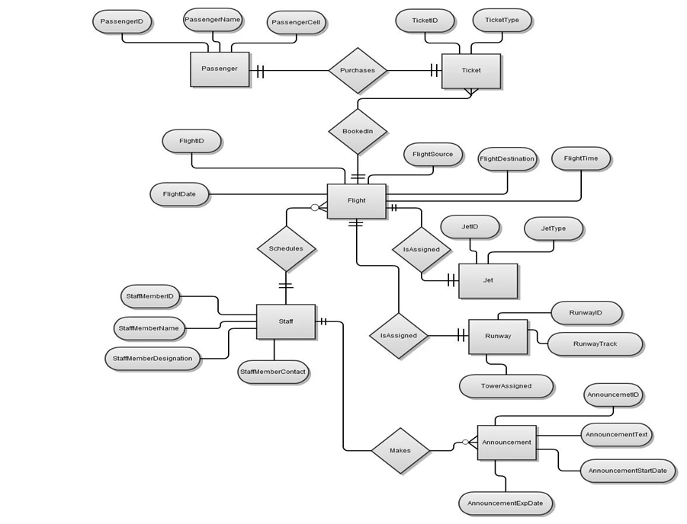
ENTITY RELATIONAL DIAGRAM

Slide 5
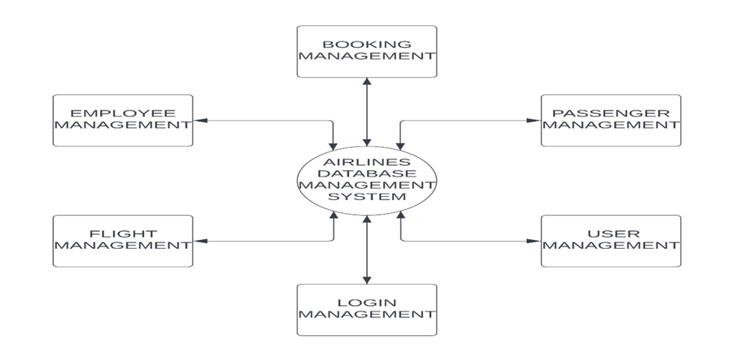
DATA FLOW DIAGRAM

Slide 6
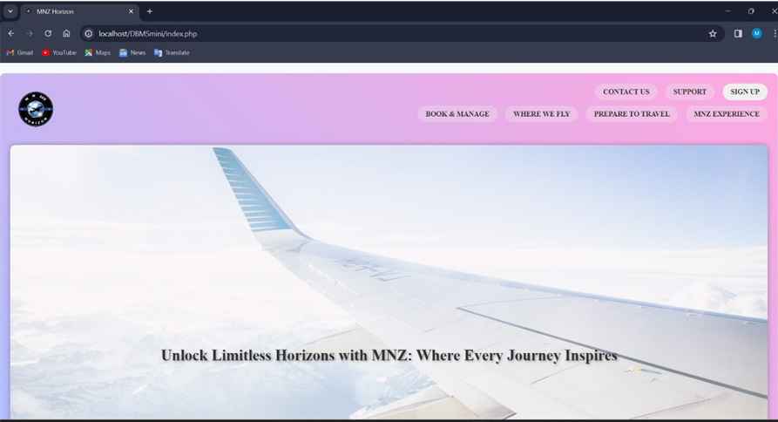
HOME PAGE

Slide 7
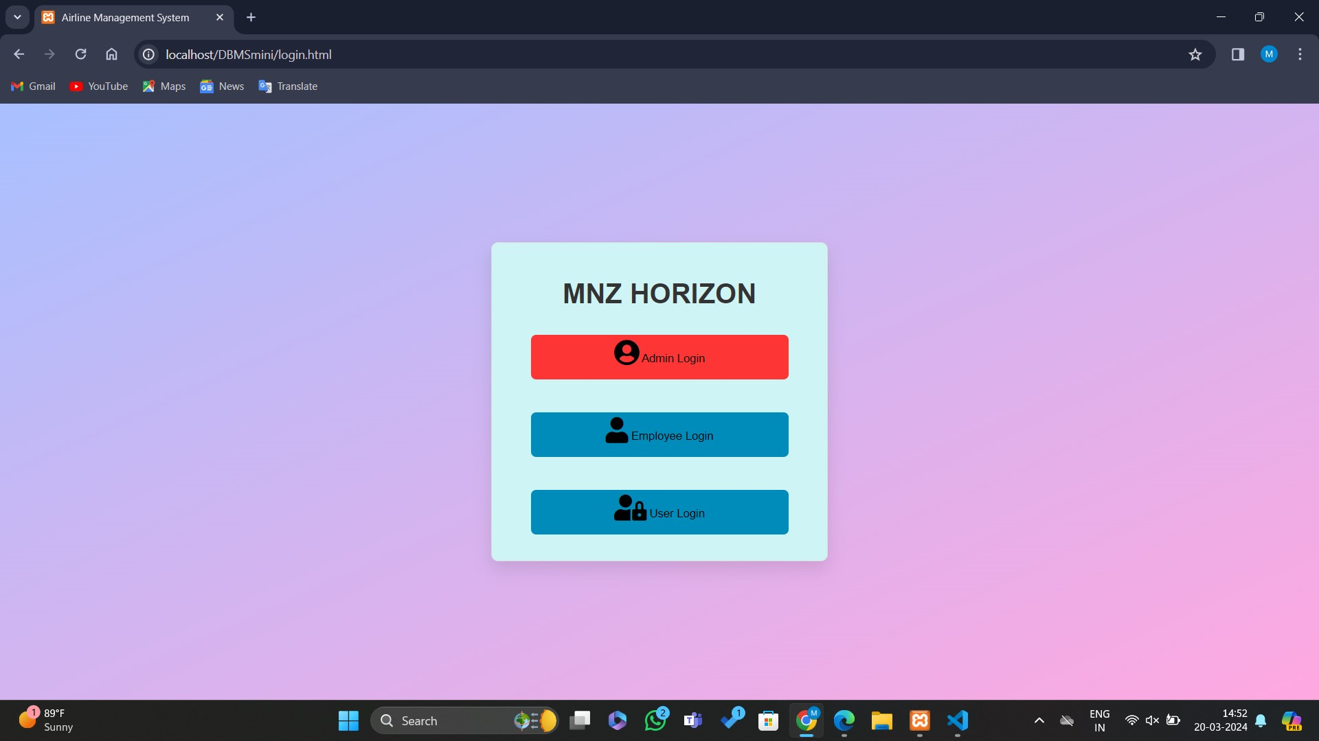
CATEGORY

Slide 8
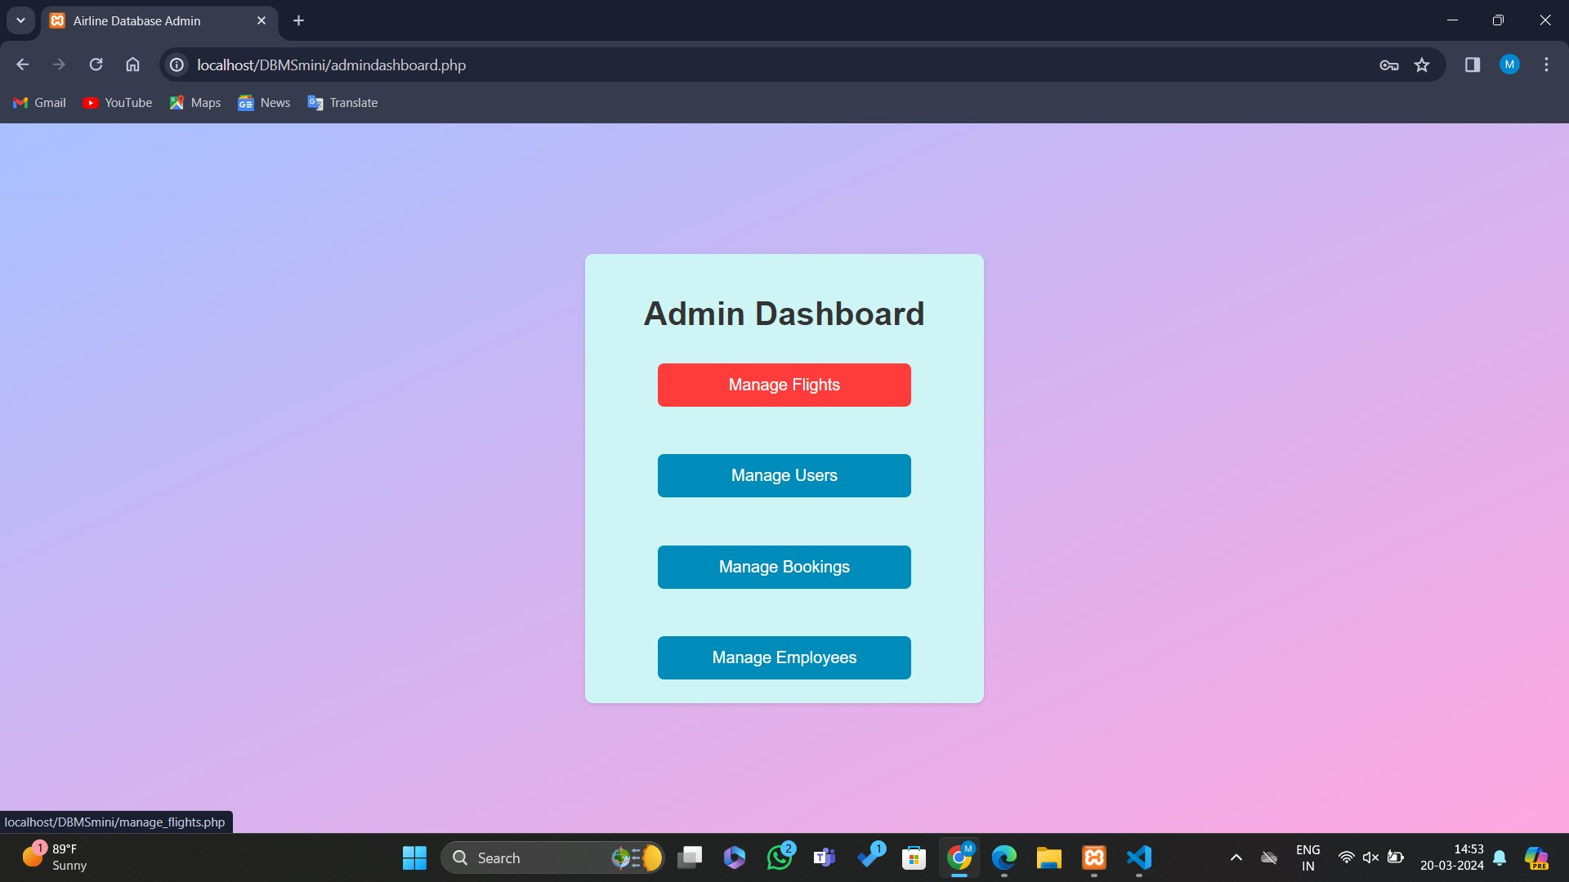
ADMIN DASHBOARD

Slide 9
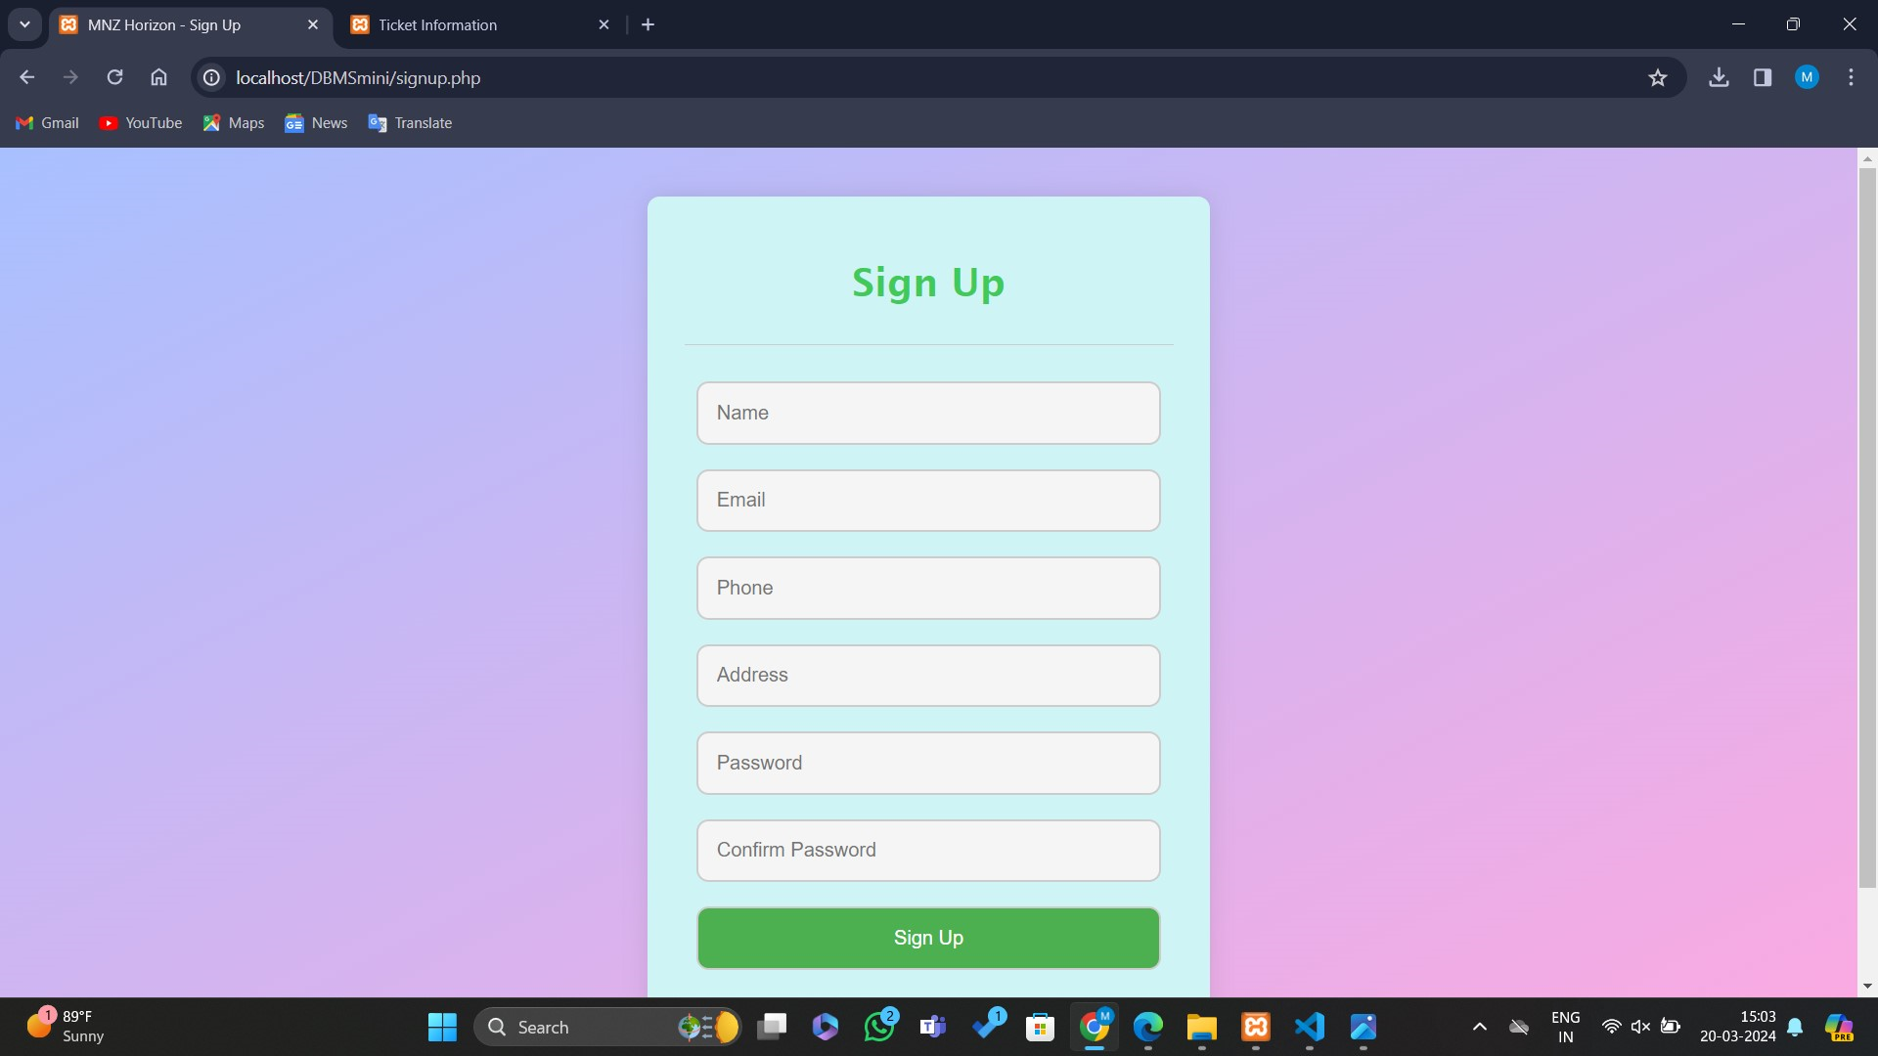
SIGNUP PAGE

Slide 10
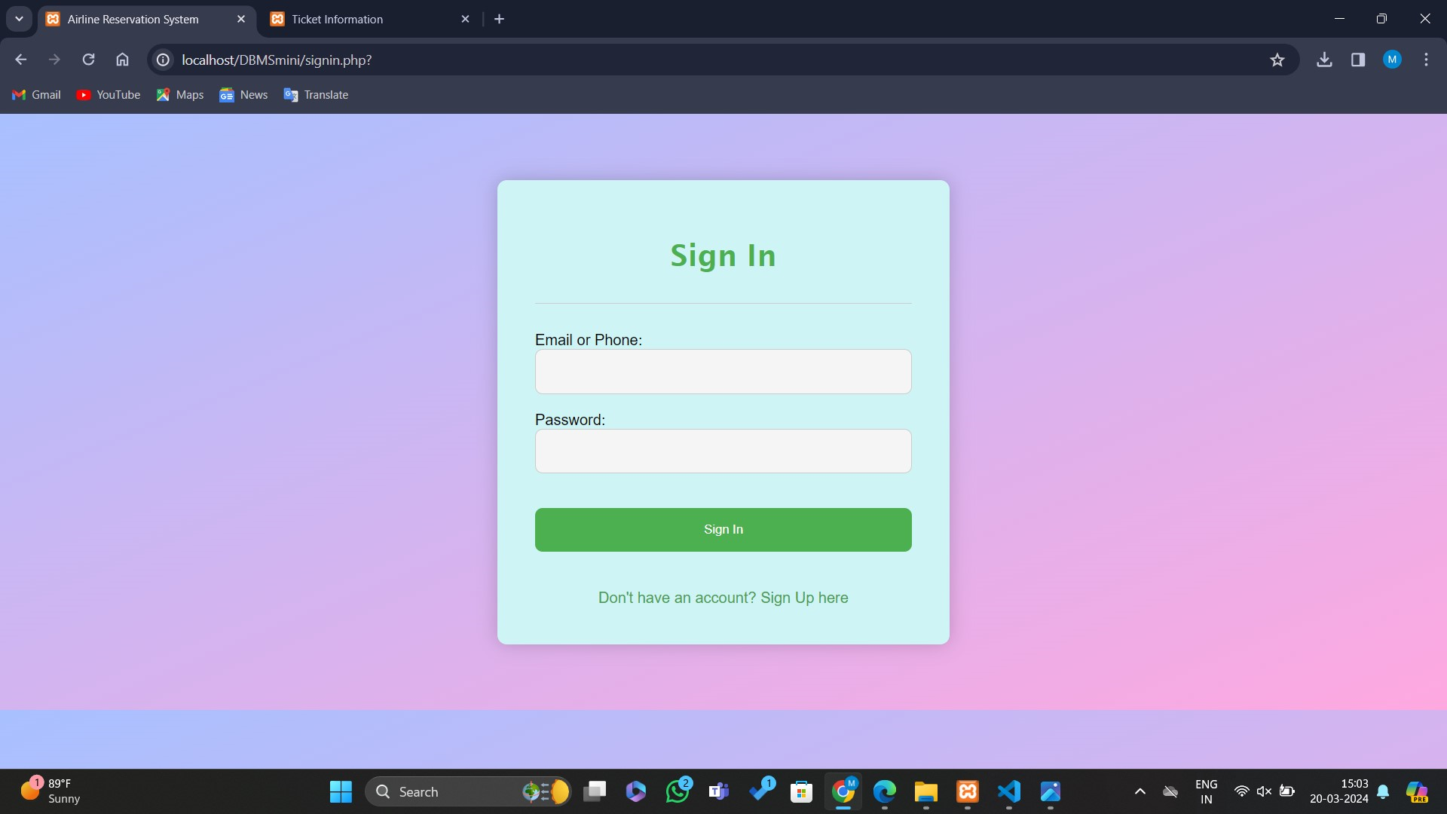
SIGN IN PAGE

Slide 11
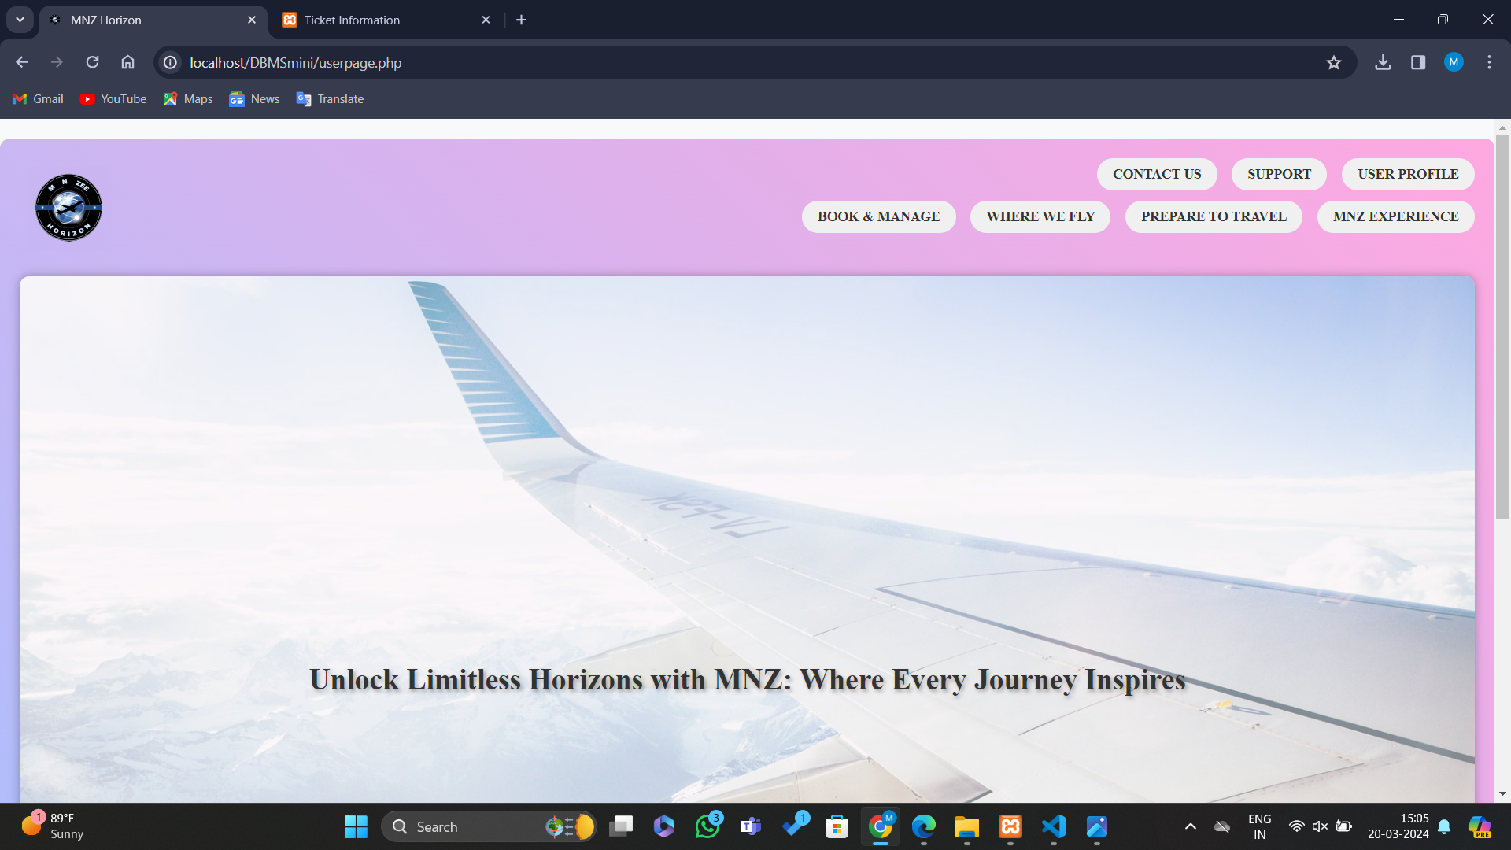
USER PAGE AFTER SIGN UP

Slide 12
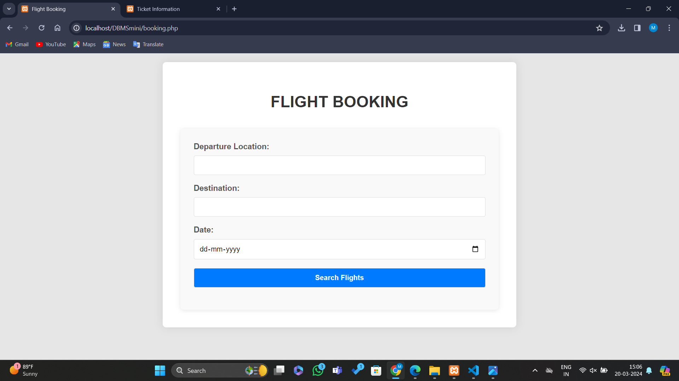
FLIGHT BOOKING

Slide 13
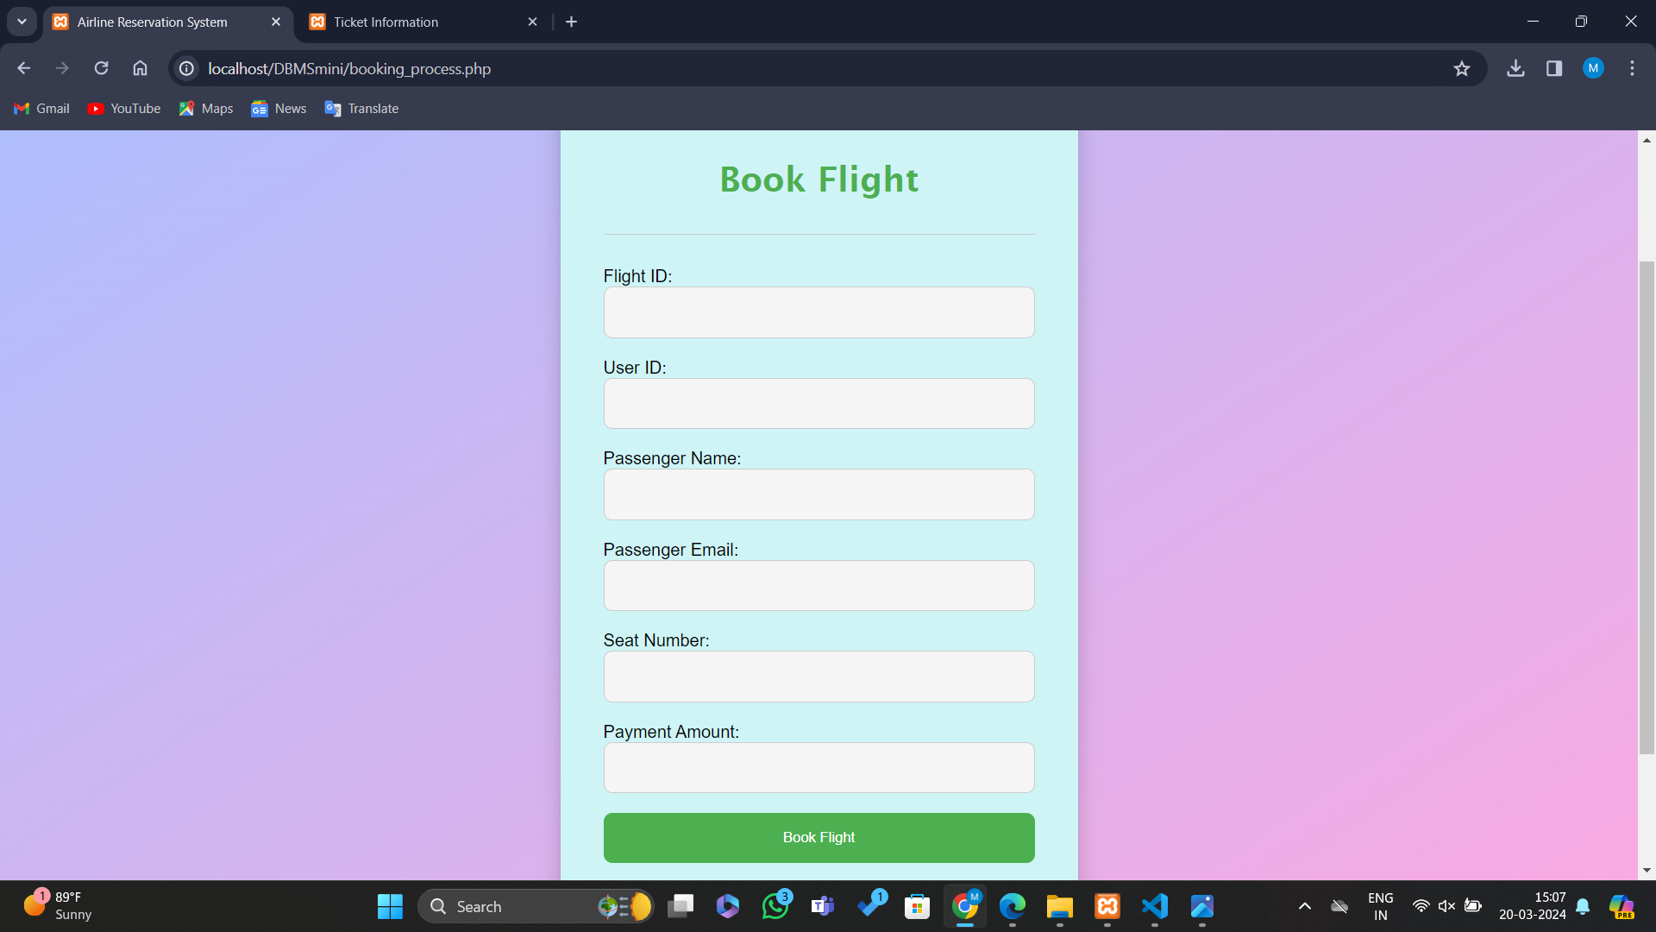
BOOK FLIGHT

Slide 14
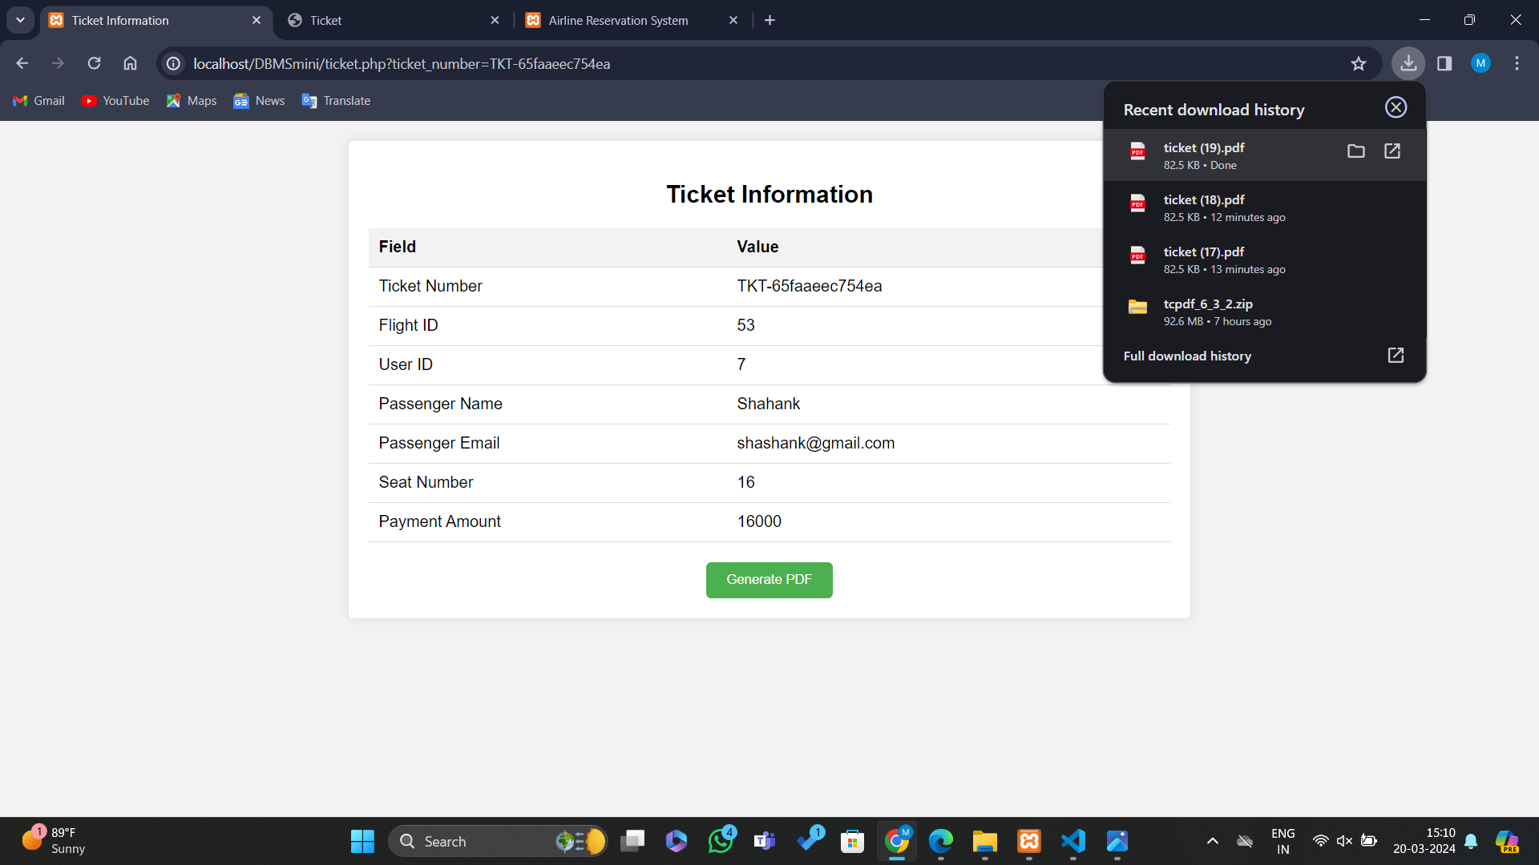
TICKET INFORMATION

Slide 15
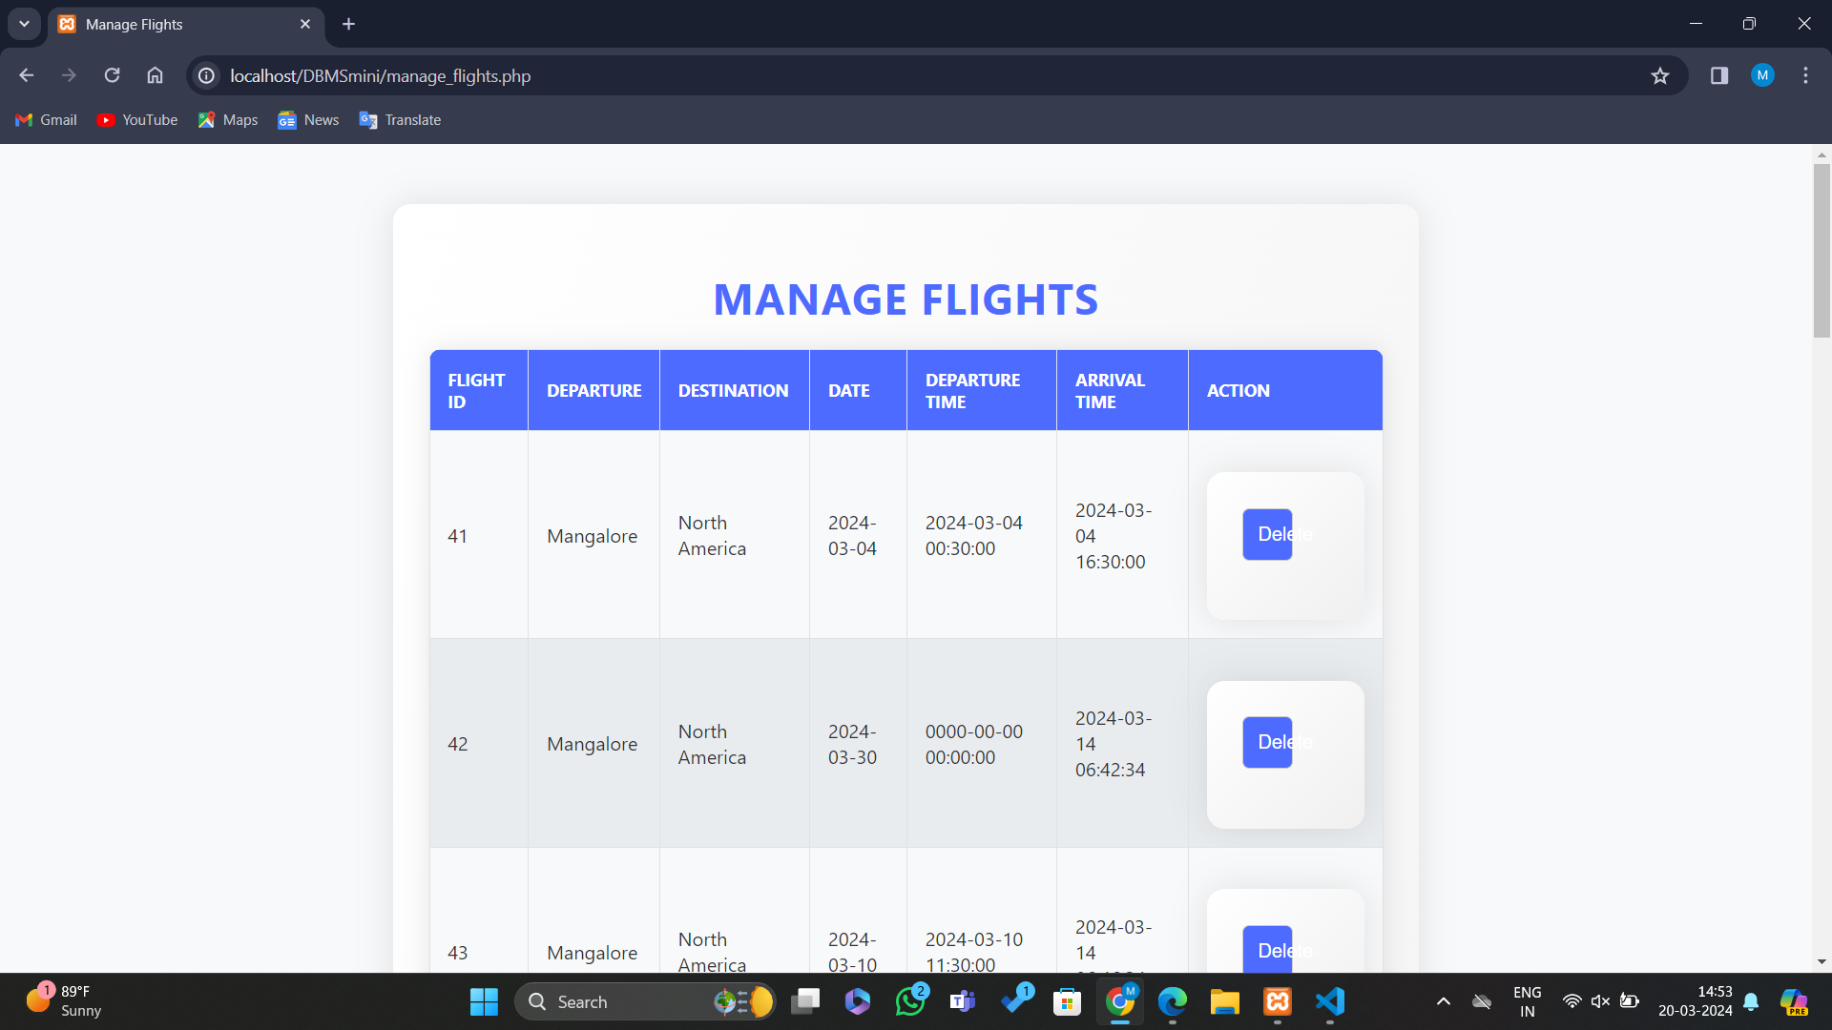
MANAGE FLIGHT

Slide 16
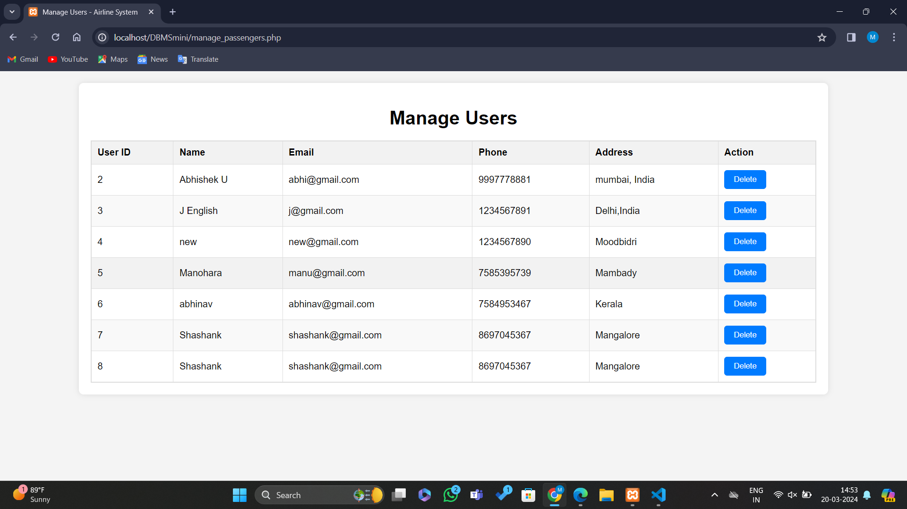
MANAGE USER

Slide 17
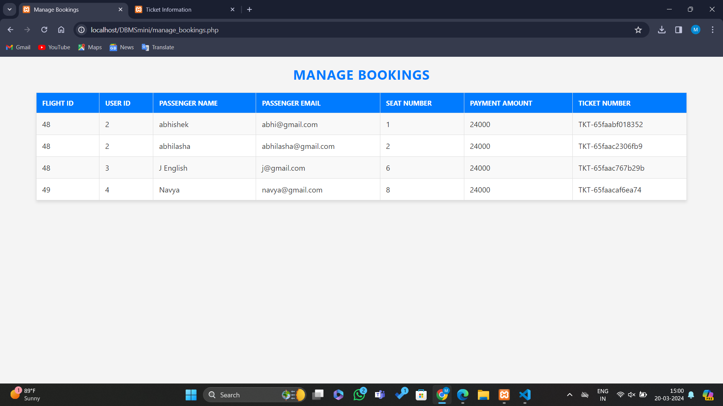
MANAGE BOOKING

Slide 18
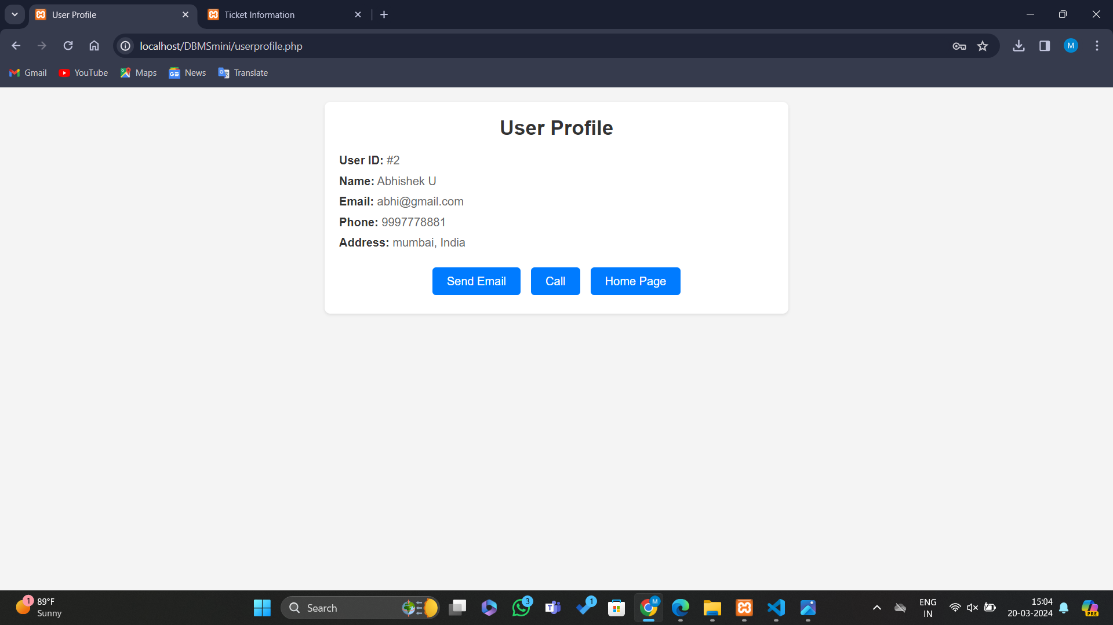
USER PROFILE

Slide 19
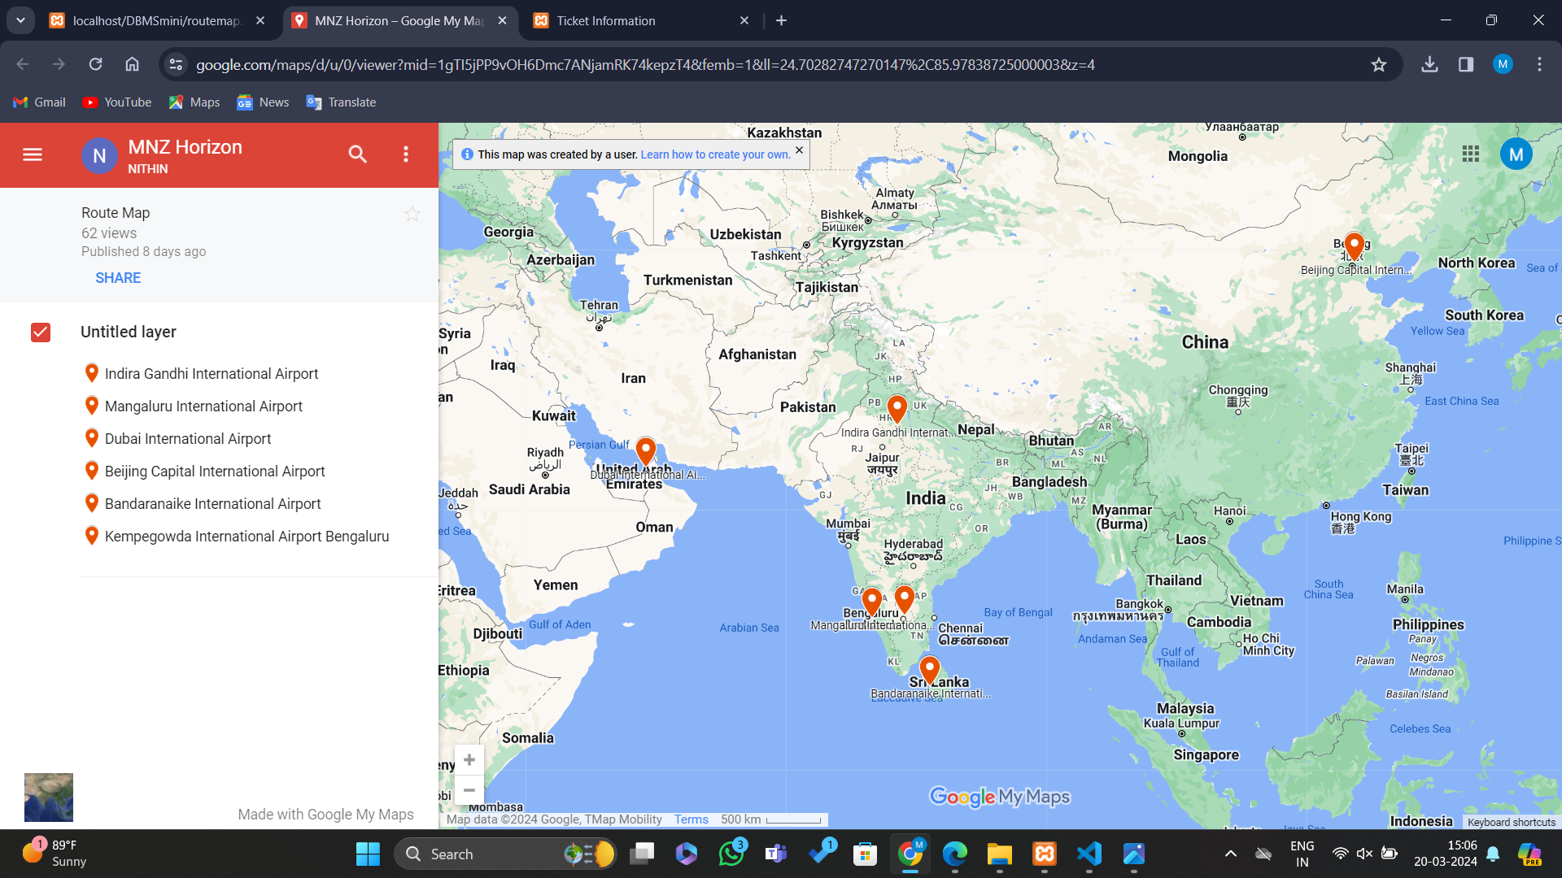
ROUTE MAP

Slide 20
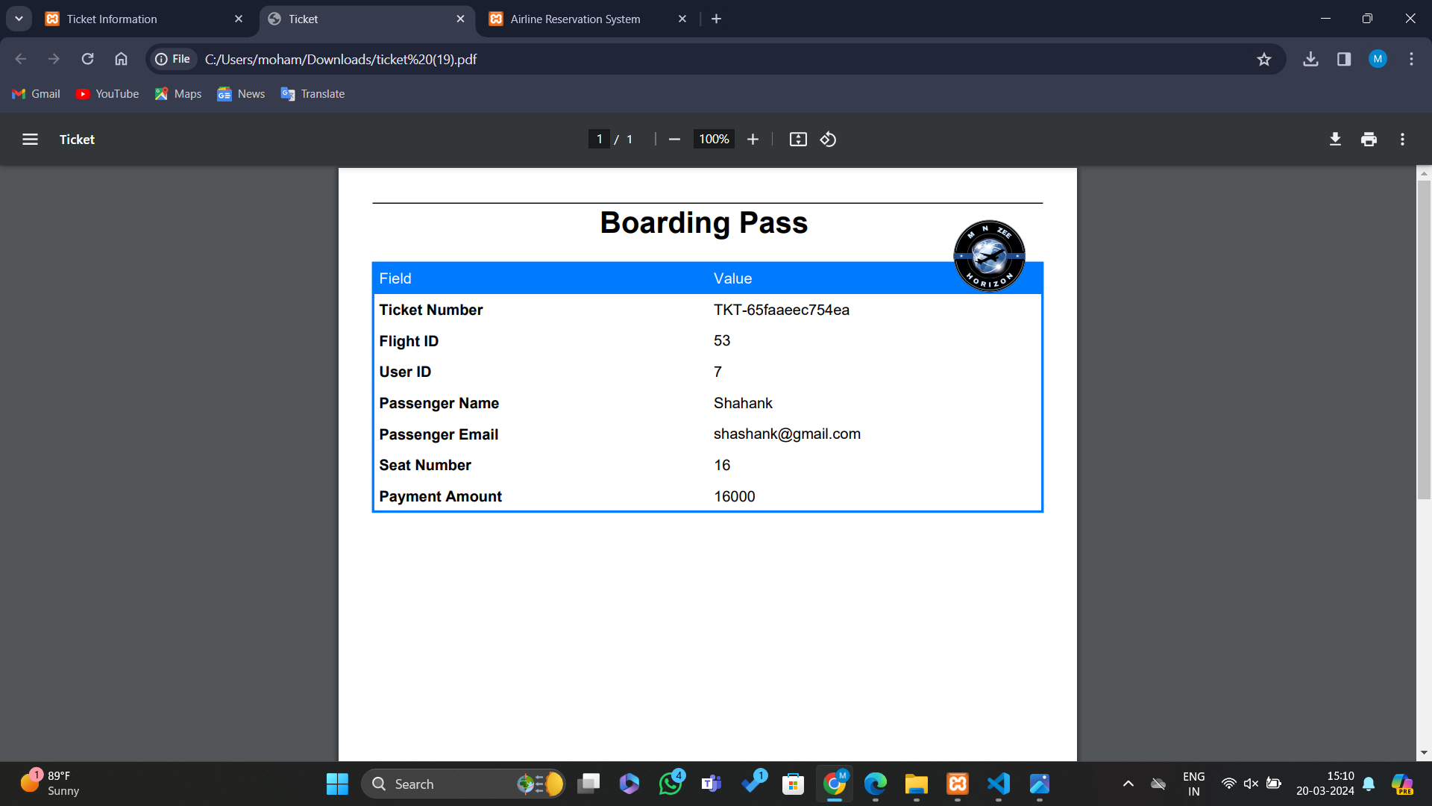
BOARDING PASS

Slide 21
CONCLUSION
With our Airline Database Management System, airlines can embark on a journey towards operational excellence, customer satisfaction, and sustainable growth. Join us in revolutionizing the future of aviation management.

Slide 22

THANK YOU

